Slide 1
The Justice Academy

Slide 2
Multivariate Analysis and GIS
Introduction to Multivariate Theory
Multivariate Analysis can be defined as the study or examination of the relationships that exist between real world phenomena to determine their effect upon one another and their aggregated influence upon an isolated dependent variable. Put more simply, multivariate theory suggests that many independent factors can cause or partially contribute to another variable's behavior or state. By determining which independent variables most strongly contribute to the increase or decrease in frequency of a dependent variable, the researcher is positioned to make judgments about the relationships that exist and subsequently how best to control and manage the fluctuations in the dependent variable under study. As applied to GIS, you should note that the inherent capability of these systems to stack individual layers on top of one another directly facilitates the researchers ability to examine the spatial and temporal relationships which exist between variables, and indirectly provides for a mechanism of examining hypothetical association. This does not suggest that the researcher can use GIS to supplant the more conventional mathematical methodologies for hypothesis testing, rather that GIS systems afford an opportunity to examine and observe (from a visual perspective) the spatial, temporal, and hypothetical relationships which may exist and which are validated through conventional means.

Slide 3
Variable Identification
To begin a course of instruction regarding the concepts of multivariate theory, it is essential that you become familiar with the terminology used to support this endeavor. Traditionally, the first term that you will encounter is referred to as the "dependent variable". This term is used to refer to phenomena which exist in the world, but because this particular variable that has been selected as the primary focus of the examination, we presume that it is dependent upon other phenomena for fluctuation. All shifts in frequency, modifications to its occupied space, and in some cases, its very existence, relies upon the presence and influence of other contributive factors. These "independent variables" which cause the dependent variable to shift, shrink, or wink out of existence, do so because, in the grand scheme of things, they have a direct impact. Although they act independently, and as such, shift or morph because of other things, their individual variance causes the dependent variable to fluctuate because of the relationship which they exert and which is shared between them.

Slide 4
Hypothesis Formation
Empirically oriented scientists develop what are termed "research and null hypotheses" based upon a review of pertinent literature about these factors. By examining other scientists work relative to the subject and through their own observations of the phenomena under study, they develop a theoretical postulate about these variables and any relationships which may exist between them. Subsequently, they develop research and null hypotheses regarding these factors. The research hypothesis is always a positive statement about the potential relationship between the independent and dependent variables, while the null hypothesis represents a negative summation and proposes that no relationship exists whatsoever. Modern empirical methodologies reinforce this skeptical view, until proof is offered (by means of statistical verification) that a relationship does in fact exist. Accordingly, the scientist always adopts the null hypothesis until they are offered proof to confirm that the relationship is not just suspected, but verified.

Slide 5
Correlation Assessment
Under the more traditional methods of statistical analysis, proving hypothetical relationships involves the use of the Pearson's Product Moment Correlation Coefficient (r) which is used to measure the comparative frequency shifts between the X (independent) and Y (dependent) variables, the deviation values, the squared deviation between the variables, and ultimately the sum of the squares. By dividing the sum of the squares by the number of observations in the sample, multiplied by the standard deviations for the X and Y variables, the degree of association between the variables can be determined. In turn, by comparing the calculated value for (r) against a standard table of relative strength (.00 to 1.0), the degree of influence maintained by the independent variables against the dependent variable can be measured. A Pearson's r of .80, for example, would indicate a relatively strong degree of relationship between the independent and dependent variables. This would mean that as the frequency in X rises or falls, the frequency of Y will rise and fall correspondingly.

Slide 6
The Percent of Shared Variance To calculate the percentage of time that the variables fluctuate together, the Coefficient of Determination is computed. By squaring the value of Pearson's r (.80) and multiplying it by 100, you can determine that the two variables vary together approximately 64 percent of the time. This conversely means that 36 percent of the time the variables do not move up and down in unison, probably indicating that some other factors are hypothetically causative in determining the movement observed within the dependent variable. Now that you are thoroughly confused, let me reiterate that GIS systems do not supplant the need for the serious researcher, no matter their academic discipline, to forsake proficiency with the more traditional empirical methods of determining correlations, GIS systems simply allow the researcher to visually observe the spatial overlap between variables, and that this ability consequently makes the process of analysis inherently more friendly.

Slide 7
A Brief Recap of the Process To recap the appropriate empirical process, the researcher should develop a well defined hypothesis, which is supported by sound theoretical premises, and then collect information and data according to an unbiased sampling strategy. Once collected, the data is examined using correlation analysis procedures to determine if the associations expected in the hypothesis are true or false. If the correlation coefficients are strong enough and the level of significance is calculated beyond the .05 or .01 (95% or 99% levels), then a measured association about the observed relationships of the sample can be surmised and inferred back to the total population. Relative to this form of analysis within a Geographic Information System, the researcher is in many cases actually observing and quantifying the variables for the entire micro-level population, rather than a small random sample within a specified geographic region and subsequently, this limits the utility of the inferential part of the standard correlation procedure. If the entire population of phenomena is not included however, then the need for inference is still critical.

Slide 8
The natural temptation when conducting such research is to oversimplify the number of causal variables in the equation and to treat all independent variables as primary sources of influence upon the dependent variable. In fact, some variables may turn out to have a second order effect upon the dependent variable (in other words they effect the variable that actually does have an influence but which may not be included in the model) and since their are no quantitative tools within GIS systems to make this distinction, it is difficult to differentiate primary from secondary causative influences. They all simply get lumped together in the same space and are layered on top of one another. This examination (distinguishing directly causal variables from secondary or even tertiary variables) should be an integral part of the hypothesis development phase of the study, not the methodological phase.
Temporal Correlations Additionally, there may exist a temporal adjustment factor which is necessary to include within the model. In a traditional statistical model, a lag or lead adjustment can be made to the dataset prior to the actual computations to accommodate this phenomena, however spatial analysis systems must rely on adjusting the spatial layers, based on the temporal parameter prior to their utilization, to insure accurate measurement of lag/lead effects. This again requires the researcher to perform analysis of such lag/lead phenomena outside the GIS environment to verify its existence or nonexistence and then make the necessary adjustments inside the GIS setting.

Slide 9
An Academic Example In the diagram below you can see an example of a theoretically, spatially, and temporally perfect correlation between four independent variables and the dependent variable. I should first point out that this will probably never happen within the real world because God did not create such a perfect world. I use this example merely to point out that the independent variables occupy the same space at the same time as the dependent variable. Given that sufficient theoretical linkages between these phenomena exists, you would conclude from this diagram, that you have isolated four contributive factors which possess a strong correlation to the dependent variable under study, and that there is sufficient spatial overlap and temporal congruity to conclude that this could not have happened by mere chance.

Slide 10
More likely to occur is the pattern illustrated in this next diagram. Some degree of spatial overlap exists between these variables and although they may be hypothetically related, the data suggests that the relationship is not mathematically perfect nor spatial perfect. It would however provide a good degree of utility if several of the independent variables used in the model were directly controllable. Such control would provide a mechanism for manipulation of the independent variables so that a desired shift in frequency can be realized within the dependent factor. This ability to control your environment and manage resources and physical systems is probably the ultimate goal of such efforts.
Simply understanding the interdependence of phenomena lends itself to the realization that certain variables are directly controllable by people and subsequently, if we know that changes in Independent Variable #1 will cause a desired increase in the frequency of the dependent variable, then we can proactively assure that we maintain the desired levels. The problems caused by such manipulation is that we rarely are clever enough to figure out that changes to one IndVar will not only have the desired effect on the DepVar by will have second and third order consequences to other physical phenomena. If you recall the effect that DDT had on the Red Tailed Hawk in California you will understand that killing bugs may be the desired first order effect, but the bug frequency was just a small portion of a greater and more complex model. By increasing the parts-pre-million of this pesticide, we changed the balance of nature and crossed over into other multivariate models and nearly wiped out the entire species of hawks. Care must be taken to insure that we do not ignore such complexities and manipulate the wrong independent variables.

Slide 11
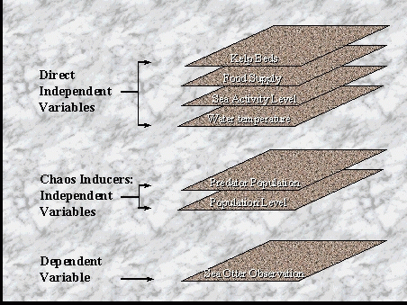
A Sort Of Real World Example This next slide reflects a more real world oriented example of a multivariate model. In this case the hypothesis suggests that sea otter frequency is determined by the presence of kelp beds, the existence of an adequate food supply, a relatively calm mean sea activity level, and a water temperature range that is tolerable by the otter colony. These variables serve as the direct IndVars and without the existence of these factors within a tolerable range, the likelihood of finding a sea otter colony is remote. Also illustrated are two variables which serve both as IndVars , but as Chaos Inducers. Pollution levels can be hypothesized as having a substantial influence over the well being of otters, but the typical state of the pollution level is well below tolerable range. If this variable dramatically increases to a point where it threatens the otter colony, then over a measureable period of time, the members of the sea otter colony will die.

Slide 12
The term chaos inducer also means that this single variable will have a dramatic effect upon the other IndVars and potentially damage the entire ecosystem. I have included the IndVar described as Predator Population within the chaos inducer layers to signify that although normally tolerable, a substantial shift in this variable would have a correspondingly negative effect upon the well being of the colony. It wouldn't necessarily impact the other variables in the equation, but an increase in Killer Whale frequency would dramatically reduce the number of colony members over a brief period of time. Recovery time from an increase in this IndVar would be substantially less than for the pollution variable. You will notice again in this illustration that the layers used lay spatially perfect upon one another. This again, would probably not happen accept in this academic example. The real world is much less predictable so you would probably notice a substantial degree of overlap, but not as perfect as shown here. What you could anticipate to see in a properly constructed GIS representation of this type of study, is a high degree of overlap between the kep bed and sea activity variables. The water temperature variable would surround all of the variables used and the food supply layer would extend well beyond the kelp and otter observation range layers. Where you would expect to find the highest concentration of sea otters would be where these IndVars overlap. Within this range, the conditions are ideal to promote otter populations.

Slide 13
Conclusion
Remember that the ultimate goal of this multivariate analysis procedure is not simply to observe the correlations between these phenomena, but based on this recognition, to identify controllable variables which can serve to facilitate the effective management of environmental resources. If your focus is not on proactive control, then you must at least come to the conclusion that such knowledge facilitates an increased ability to direct disaster recovery efforts. But before you can employ either process, control or recovery, you must understand the relationships which exist and determine which things can be manipulated by humankind.

Slide 14
Introduction To SQL in GIS
Introduction Perhaps the most powerful tool contained within GIS systems is the Structured Query Language (SQL)feature. Although it is important to be able to design data structures, to geocode data to maps, to examine the geographic distribution of phenomena, and to thematically analyze data, it is inherently more valuable to possess the ability to ask questions about the phenomena under study and display the results of such queries. Most GIS systems have now adopted SQL as their primary query medium and the raw advantage offered by SQL over previous forms of query languages, is that SQL offers a standard format which is easily mastered and which is incredibly user friendly. The SQL language is very powerful and provides a wealth of syntax which optimizes the relational database structures used to collect information. SQL, like English, is a recursive language. The syntax of a query can be the output of a successive nesting of queries and consequently, almost any question can be answered by constructing a single SQL query. All of the major Relational Database Management Systems use SQL and since most databases are designed within these RDBMS systems, it naturally follows that GIS users will benefit by incorporating this query tool within the GIS environment.

Slide 15
SQL uses what are termed relational and other types of operators for performing comparisons and derivative functions. These operators enable the user to construct queries and provide for the assimilation of data stored in separate databases to be reorganized into one desired output table. Remember, that in order to optimize the benefits of component file layering and GIS's ability to facilitate multivariate correlation analysis, databases were initially normalized into a small collection of individual tables. These tables have been constructed in a fashion which singularizes data entities and attributes and which possess a prescribed relationship to each other based upon the logical interrelation of the phenomena.
One-to-one, one-to-many, and many-to-many relationships are prescribed during the data design phase and it is the key field of a table which facilitates a match between one table and another table. It is sometimes necessary to "join" data from different data sets and this process is made possible by the primary key fields contained within each data table. A properly designed database allows you to express all types of table relationships between sets of data. Subsequently, it is necessary to use SQL to cross reference these individual tables, join them where necessary, and derive a new table or "View" with the desired output. In order to achieve this, it is also necessary to incorporate the use of relational operators such as (<, >, =, >=, <=, or <>) in order to facilitate the desired comparisons.
GIS systems use these basic relational operators, along with a special set of task specific commands to facilitate horizontal queries between data tables and vertical queries between relational databases and geographically oriented data.

Slide 16
The Basics In SQL, there is a standard form used to develop queries. The primary format is as follows: Select (the fields you wish to have displayed) From (the tables which contain these fields) Where (the key fields match between the tables) This simple format is the cornerstone to all explorative processes which you will perform. Before you can use this language to extract and process data, it is absolutely necessary that you understand the manner in which the data tables were constructed. Without this awareness, it is virtually impossible to formulate a coherent question and then generate the corresponding SQL script which extracts information in the desired format. For purposes of this tutorial examine the tables of data below.

Slide 17
These data tables identify two distinct entities. The first entity is named "Otter_Obs" and you will notice that it contains several attributes relative to information which pertains to direct examination of sea otters in the wild. Information was collected about each individual sea otter at the time that the observation was made. Data that could be collected based on direct observation was recorded into the Otter_Obs table. The structure of the table is as follows:
Field Name Field Type Field Width
Tag# Character 5
Gender Character 1
Weight Numeric 2
Length Numeric 2
Age Numeric 2
Colony# Character 1
Region_Obs Character 2
Date_Obs Date 8

Slide 18
At the time of the capture, a blood sample was drawn. The Tag# of each otter was recorded on the label of each blood vial and the sample was sent to the Veterinary Laboratory for analysis. After the blood was analyzed, relevant information was recorded on a separate data table called Vet_Data.
The structure of the table can been seen above:
Field Name Field Type Field Width
Blood_type Character 5
Parasites_1 Character 15
Parasites_2 Character 15
White_Cell Numeric 5
Disease_1 Character 10
Disease_2 Character 10
Tag# Character 5

Slide 19
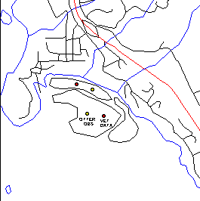
The SQL Interface Many GIS Systems have adopted the use of a graphical user interface to support not only the GIS environment, but also to include the generation of SQL queries. The MapInfo product line uses such GUI interfaces to simplify the process of code generation and to achieve a shallow learning curve for novice users. Included within the SQL generator is a "sytax error" recognition routine which checks the syntax of the query before the script is actually executed. To compose an SQL query, the first step in the process is to open the corresponding map file, boundary file, and two database files which will be used. In this case, will must first geocode the Otter_obs and Vet_Data files to the boundary file called "Otter_Grid". This file represents an artificial grid layer, within which we anticipate locating the sea otter colonies.

Slide 20
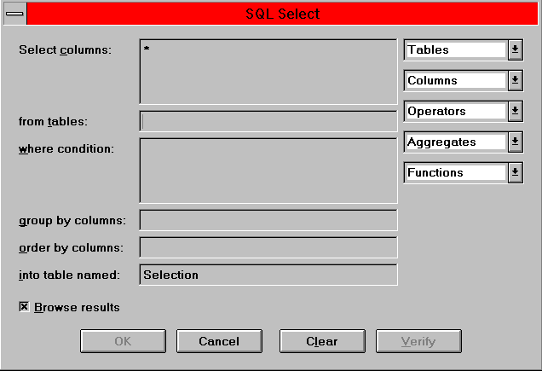
In keeping with multivariate correlation theory, it was created after a cursory review of the area and conforms somewhat to the distribution of kelp beds in the region. The spatial key used to facilitate the geocoding process is the inclusion of an attribute in both the boundary file and the databases which is called "Region_Obs". This means the region in which the sea otter was located at the time of capture. The regions were quantified with a capital letter designator. After the files have been successfully geocoded and all records within both databases have been successfully processed, we are able to perform SQL. The graphic below illustrates the user interface which you will see after you have selected the "Query>SQL Select" option from the dialog box. Down the left hand column you will see the Select Columns, from Tables, and Where condition prompts. When you first begin, MapInfo will place the cursor in the "from tables" box and will place an asterisk in the "Select Columns" box. At this point, MapInfo is telling you that it is ready to select all attributes and it wants you to specify the table you wish to use.

Slide 21
Down the right and side of the dialog, you'll notice that there are several buttons descending vertically. The Table, Column, Operators, Aggregates, and Functions buttons are active and you may point and click on them to select the appropriate options which are available. Depending upon the number of files you have open at any given time, the content of these boxes will change. If you are looking for a specific database and you don't see it listed in the Tables or Columns box, then you have most likely not yet geocoded the database to the map or you have forgotten to open the file. Whichever files are currently open will be displayed whether or not they have a logical relation to one another. In this particular example, you should see that the NorthC (map) and Otter_Grid (boundary) geographic files are in use, along with the Otter_Obs and Vet_Data databases.

Slide 22
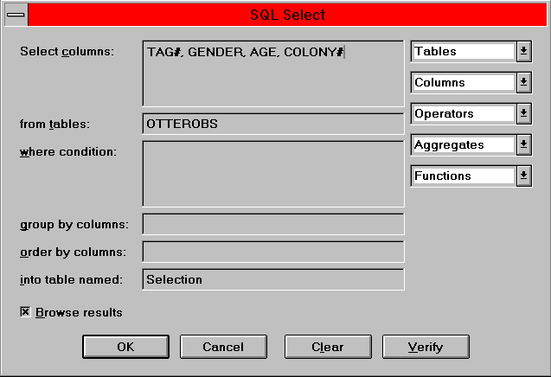
The next step in the process is to decide upon the content of the query you wish to execute. For this example lets assume that we wish to see the Tag#, Gender, Age, and Colony# of all animals examined. By pointing to the Tables button and selecting the Otter_Obs database, MapInfo will insert the phrase Otter_Obs in the "from Tables" box. This tells MapInfo that this is the table we wish to examine. Next, we move the cursor to the "Select Columns" box and highlight the asterisk. With the asterisk still highlighted, we next point to the Columns button and select the field called Otter_Obs.Tag#. Since we have multiple files open at the same time, MapInfo requires that we identify not only the name of the attribute we wish to use, but the name of the table as well. This avoids confusion were there are two fields with the same name, but which are located in different databases. We continue the process until all of the desired fields have been selected. At this point, our SQL dialog should look like this:

Slide 23
At this point it is advisable to push the "Verify" button. MapInfo will ensure that the syntax is correct before attempting to execute the SQL query. This is obviously not a problem for simplistic queries such as the one we have created, but it will become more imperative as the complexity of your queries advance. By pushing the "OK" button located along the bottom row of the SQL dialog, MapInfo will execute the query that you have composed. The results of the query will be returned in two fashions. MapInfo will provide a "Browser" of the results and will also highlight the points on the map which represent the spatial location of each animal. The Browser can be saved as a new table of data in either a DBF, ASCII, or Excel format. The map can either be printed or exported to a raster image format. One of the interesting advantages offered by the MapInfo product line is that each individual query is given a temporary name. A "Query1" name designation is assigned and these can be treated as distinct layers. In other words, after you have used SQL to isolate instances which match the desired criteria, you can use the Map>Layer Control option to replace the layer which portrays all otter sightings with just those which were returned by the SQL script. This feature is very important when you are dealing with large databases.

Slide 24
At this point we need to become aware that there are two basic types of information. Explicit Information is information that is actually contained within the data table. The value of a record entry is considered to be explicit. In other words, when you physically view the contents of a table, you actually see the value. Derived Information on the other hand, is information that can be calculated from the explicit information in a table, but that is not directly present in a table of data. Structured Query Language maintains the ability to select and use explicit data and subsequently process derived information. To achieve this, the user must utilize specific programming language commands and embed these commands into the Select Columns part of the script. As applied to our example, we could insert a SUM(AGE)/5 "Mean Age" statement within the Select Columns dialog to derive the mean age of the sea otter colony.
SQL would add the ages of each otter observed and divide the total by 5, which is the number of sea otters in the database, and under a new heading called "Mean Age" would reflect the derived value. More complex forms of derived information can be programmed in SQL depending upon the skill of the user. Generally speaking however, it is adviseable for users with limited programming skills to seek the assistance of professional computer scientists when engaging in the process of more advanced programming functions. By employing the skills of SQL programmers, GIS'ers can concentrate on the practical matters of utilizing the GIS tool rather than spending inordinant amounts of time worrying about SQL syntax. I don't mean here to discourage you from attempting to learn how to write advanced SQL programs, rather to call to your attention the need to be efficient.

Slide 25
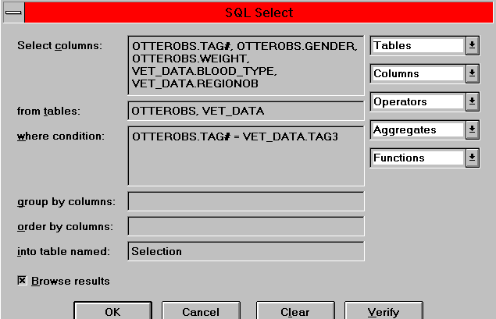
Continuing with our exploration of SQL, we must focus upon the next concept called Relational Joins. This function is critical to the objective of linking two database tables based upon the primary key field that we have built into each database. As I mentioned earlier, MapInfo will display the name and fields of any tables currently opened. In some cases, we may wish to extract selected fields from both the Otter_Obs and Vet_Data tables. In order to achieve this, we must execute a relational join in the "Where Condition" dialog. This is mechanically very simple and can be accomplished in a single line of code. In fact, MapInfo will provide some assistance toward this end. After you have identified the Tables to be used and you have used the Columns button to identify those fields you wish to include within your Select From dialog, MapInfo will write a temporary join command in the Where Condition dialog. The line will say something like Otter_Obs.obj=Vet_Data.obj. This is not an acceptable command, but reminds you that you must specify the primary key fields contained in both data tables before the program can be executed. At this point you must change the line that MapInfo put in with Otter_Obs.Tag# = Vet_Data.Tag#. This will define the appropriate primary key and will extract the fields desired from the appropriate tables and insure that the correct explicit information is portrayed from either database relative to the sea otter based on their tag number. For this tutorial, I have constructed the following SQL script to illustrate the technique.

Slide 26
As you can see, explicit information from the two different tables was included within the browser. Without such a join, MapInfo would have no way of cross referencing the two tables. This process can get a bit involved, especially when you are attempting to link relational databases along with a vertical reference to a map or boundary object.
In other words, you first link two databases based on the primary key and then add a condition which measures the spatial location. An example of this effort might involve selecting the Weight, Age, and White Cell count for only those animals captured within all Regions of the study, but where kelp regions overlap food supply regions. This added spatial concern invokes the necessity to not only specify a horizontal join between databases, but forces an extra vertical condition into the scripts Where dialog. Unfortunately, these types of queries are not rare. GIS'ers use this type of added condition all the time when analyzing the relationships between animal populations and most desired geophysical attributes. The good news is that we don't have to cover this topic until the advanced SQL lesson. But before you abandon all thoughts of this feature, remember that when specifying any form of join in a where condition, you have to be careful about the order in which you enter the columns names. The columns in the Where condition must be entered in exactly the same order as their parent tables are listed in the From tables statement. Additionally, the clauses where you specify how to join the tables must come before any other conditions in the Where dialog. The graphic above illustrated this rule.

Slide 27
Constructing Expressions
Expressions are formulated within the Select Columns box of the SQL dialog. Here are some examples of some slightly more complex expressions.
POP_1990 > 500000
POP_1990 <= POP_1980
County <> "Los Angeles"
POP_1980 * 5.5
POP_1990 / Total_Area
round (POP_1990/Total_area, .1)
The first three examples use comparison operators. The first tests to see whether the 1990 population is greater than some constant (500000). The second tests to see whether the value of one column is less than or equal to the value of another column. The third tests to see whether or not the county is Los Angeles. When the county does not equal (<>) Los Angeles, the record is selected. You could use any of these expressions in the Select or Where Condition clause of the SQL dialog. These commands allow you to select a subset of the records in a table. The expression defines the characteristics of the subset. The later examples use arithmetic operators and produce derived information.

Slide 28
Nested Conditions SQL allows the programmer to nest conditions. In other words, you may put together a string of conditions and have them executed in a particular order. This allows you to construct derived information that can be controlled and used for additional processing or comparison against other derived information or explicit information sets. The example below reflects a nested condition statement.
round ((POP_1990*1.2)/Total_Area)
This example instructs the computer to first select the total population for 1990 and multiply the value by 1.2. After it calculates this value, it will divide the product by the value contained within the Total_Area field. The derived product will then be displayed. Much more complex forms of nested condition statements are commonly constructed to support analyses and as your familiarity with GIS and SQL increases, you will be able to compose these types of advanced processes.

